Slide 1

Advanced x86: BIOS and System Management Mode Internals SPI Flash Protection Mechanisms
Xeno Kovah && Corey Kallenberg
LegbaCore, LLC

Slide 2
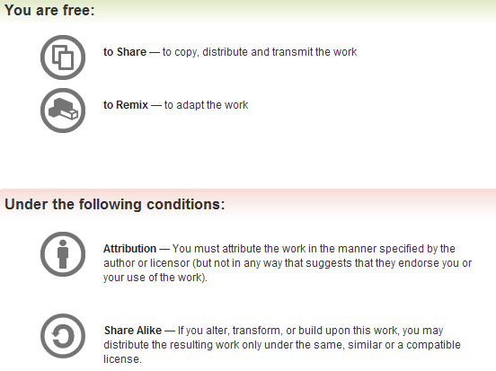
All materials are licensed under a Creative Commons “Share Alike” license.
http://creativecommons.org/licenses/by-sa/3.0/
Attribution condition: You must indicate that derivative work
"Is derived from John Butterworth & Xeno Kovah’s ’Advanced Intel x86: BIOS and SMM’ class posted at http://opensecuritytraining.info/IntroBIOS.html”
Notes:
Attribution condition: You must indicate that derivative work
"Is derived from John Butterworth & Xeno Kovah’s ’Advanced Intel x86: BIOS and SMM’ class posted at http://opensecuritytraining.info/IntroBIOS.html”

Slide 3
How to stop someone from writing to your BIOS
AKA “How to stop an attacker from writing to your BIOS”
AKA “What the BIOS vendors are typically configuring wrong when they’re supposed to be stopping attackers from writing to your BIOS”

Slide 4
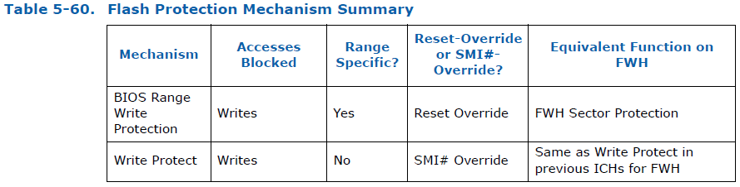
Flash Protection
With no Flash Descriptor present, the only mechanisms to lock the flash are:
BIOS Range Write Protection
Global Flash Write Protection
The reference to FWH Sector Protection yields no results in any datasheets. I am assuming it is related to the R/W control shown in the sample FWH register map at the beginning of the BIOS Flash section

Slide 5
Flash Protection Mechanism #1
Covering this first because I believe it to be your first line of defense to protect your BIOS flash from writes
Applies to the entire flash chip (Global Flash Protection)
Provides SMM the ability to determine whether or not a request to unlock the BIOS flash for writing will be permitted
This protection is provided by the chipset (not on the flash itself)
Notes:
*** There is literally no info on FWH Sector Protection…not even in the really old ICH datasheets nor BIOS Ninjitsu
*** Verify writes to PD section are still blocked…
Just to hammer it home: It is really important to lock down SMRAM!!!

Slide 6
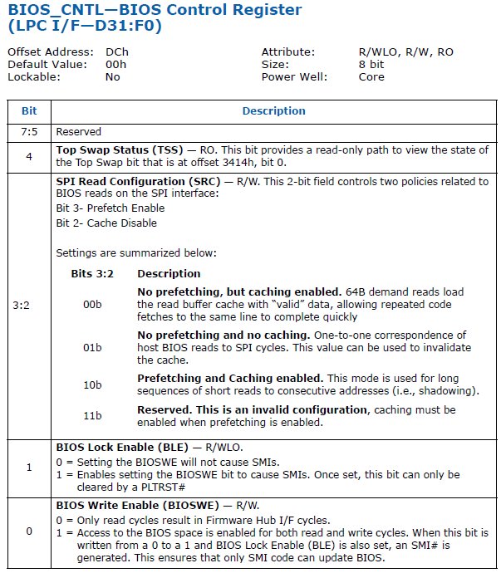
Global BIOS Write Protection
On MCH/ICH systems, bits 7:5 of the BIOS_CNTL are reserved
On this system BIOS_CNTL is located in the LPC device (D31:F0, offset DCh)
These protections would also apply to the Firmware Hub (FWH) if the BIOS were located there.

Slide 7
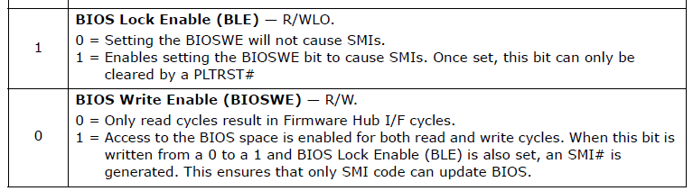
ICH/PCH Chipset SMM-derived Write Protection:
BIOS_CNTL.BIOSWE (bit 0) enables write access to the flash chip
Always R/W
BIOS_CNTL.BLE (bit 1) provides an opportunity for the OEM to implement an SMI to protect the BIOSWE bit

Slide 8
How you should think of BLE
CPU
RAM
SMRAM
(SMI Handler)
I help!
I sort of provide BIOS access control!
ICH or PCH
SPI
Flash Chip

Slide 9

How it works
SMM
Privileged Application
BIOS_CNTL
BIOS_CNTL.BIOSWE = 1
BLE = 1
BIOSWE = 0
Privileged app wants to write to the SPI flash, sets BIOS_CNTL.BIOSWE to 1
The only reason privileges are needed is to execute the in/out instructions

Slide 10
How it works
SMM
SMI
Privileged Application
BIOS_CNTL
BLE = 1
BIOSWE = 1
The BIOS_CNTL register has the BIOS Lock (BLE) enabled
Asserting BIOSWE while BLE is set generates an SMI#
SMI# is initiated by the Chipset (ICH)
The processor transitions to System Management Mode

Slide 11
How it works
No no no, this will never do…
SMM
Privileged Application
SMI Handler
BIOS_CNTL
BLE = 1
BIOSWE = 1
A routine in the SMI handler explicitly checks to see if BIOS_CNTL.BIOSWE is set

Slide 12
How it works
Much better
SMM
Privileged Application
Zeroes BIOSWE bit
BIOS_CNTL
BLE = 1
BIOSWE = 0
The SMI handler flips this bit back to 0, disabling writes to the serial flash
Since updates should be applied only by SMRAM, SMRAM knows that unless it flipped this bit, this bit shouldn’t be flipped.

Slide 13
How it works
Heh heh heh
Aw
SMM
Privileged Application
BIOS_CNTL
BLE = 1
BIOSWE = 0
From the app’s perspective, it appears the BIOSWE bit was never even asserted.
Of course this only works if:
BLE is asserted/enabled
There is a SMI handler explicitly checking/resetting the BIOSWE bit
SMIs cannot be somehow suppressed (you already saw 1 way)
Notes:
The nerd in me wants to remove SMM’s taunting laugh because once the CPU exits SMM, SMM is no longer able to “gloat.” However, I like the gloating SMM.

Slide 14
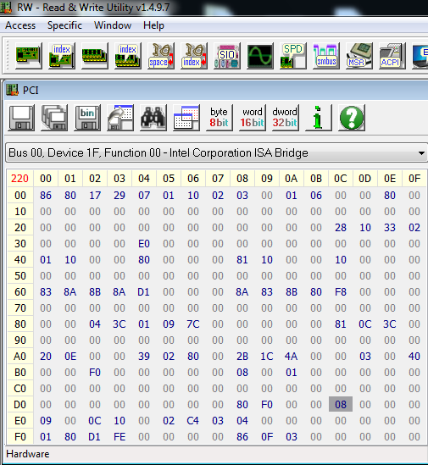
vulnBIOS example: BIOS_CNTL Testing
Look at the BIOS_CNTL register in the LPC device
BIOS Lock Enable (BLE) bit 1 is not asserted
This means any application privileged enough to either map the PCI Express configuration space or perform port I/O can assert BIOSWE to enable writes to the BIOS flash

Slide 15
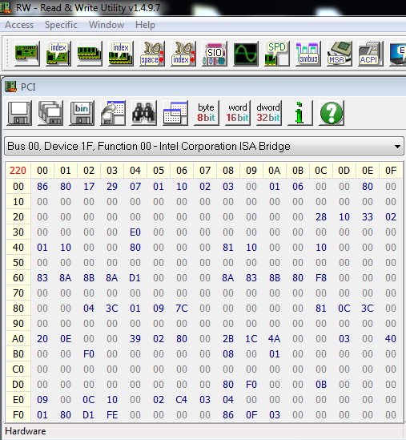
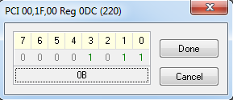
vulnBIOS example: BIOS_CNTL Testing
You don’t have to do this, but note that it is possible to set BIOS Lock Enable to 1 and not have an SMI handler routine running that checks and de-asserts BIOS Write Enable bit 0
We've seen this on multiple systems; where BLE was set, but asserting BIOSWE to 1 was not reset to 0
This is why bit 0 must be tested in order to really test write-protection

Slide 16
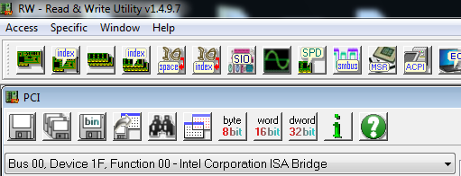
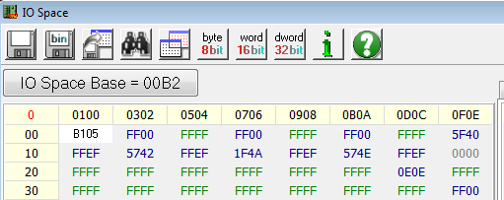
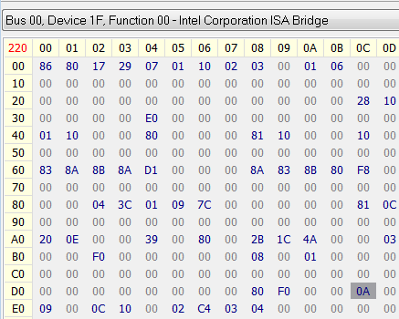
vulnBIOS example: BIOS_CNTL Testing: Set BLE
Now we’re going to setup BIOS_CNTL so that it protects the flash
This will only work on these lab machines with this modified BIOS
I inserted a custom SMI handler that resets the BIOSWE bit to 0 if it is asserted
We’re going to enable this by writing the word 0xb105 to port 0xB2
You should now see the BLE bit asserted in BIOS_CNTL (0x0A)

Slide 17
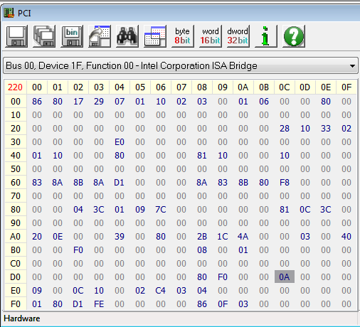

vulnBIOS example: BIOS_CNTL Testing
Now try to enable writes to the BIOS by asserting BIOSWE bit 0
Set BIOS_CNTL to 0x0B
You will notice that it resets to 0x0A
This is the SMI handler working as it should
Note the reset of BIOSWE to 0 occurs during SMM
Any tangible delay you see in resetting this value is due to the (configurable) “Refresh” button in RW-E
Bit 0 is de-asserted

Slide 18
BIOSWE/BLE should be considered deprecated!
We can defeat it on systems that are not using SMRRs
"The Sicilian" – "Defeating Signed BIOS enforcement", Kallenberg et al., EkoParty 2013
We can defeat it on systems that don't set SMI_LOCK
"Charizard" – "Setup for Failure: Defeating UEFI Secure Boot", Kallenberg et al., Syscan 2014
But Charizard actually found by Sam Cornwell, it just got merged into Corey's talk in its first appearance. Will be spun off later.
We can defeat it on systems TXT-enabled that suppress SMIs
"Sandman" – "SENTER Sandman: Using Intel TXT to attack BIOSes", Kovah et al., Summercon 2014
We have a new fundamental attack against it that will bypass BLE on all systems, once and for all. “Speed Racer” We’ll talk about these at the end, depending on time.

Slide 19
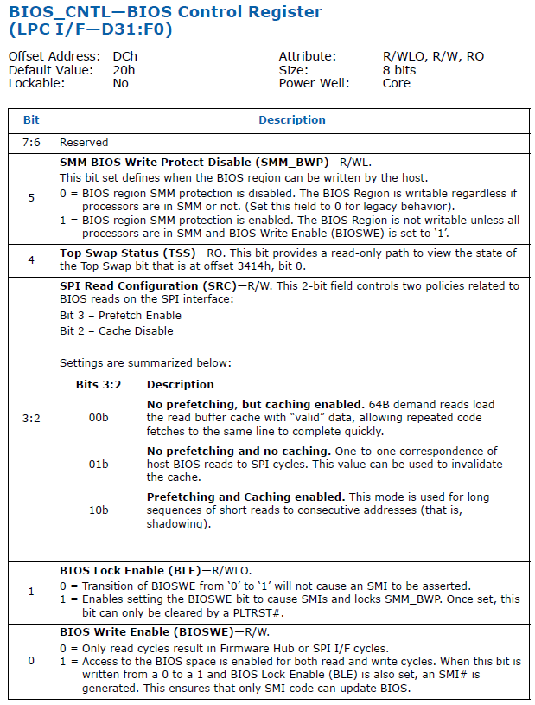
BIOS_CNTL: SMM_BWP
In PCH chipsets, bit 5 of BIOS_CNTL has been defined:
Provides the vendor the ability to ensure that BIOS region may ONLY be written to when all processors are in SMM and BIOSWE is enabled
Our lab system does not implement this bit because it is an MCH/ICH system, but check it out on your own
As we’ve seen, this register is important to lock down the BIOS to mitigate SMI suppression
Same here
Only 6 out of ~10k systems we’ve measured to date use it!!! ☹
As of 3/31/2014

Slide 20
Another Protection Mechanism
BIOS Range Write-Protection is the second major line of defense
There are 5 Protected Range registers (0-4) with independent R/W permissions
Setting these will prevent reads and/or writes until the system is reset.
* Information on FWH Sector Protection is hard to come by. It appears to be a security mechanic on the chip itself, since chips can be described as being divided into sectors.

Slide 21
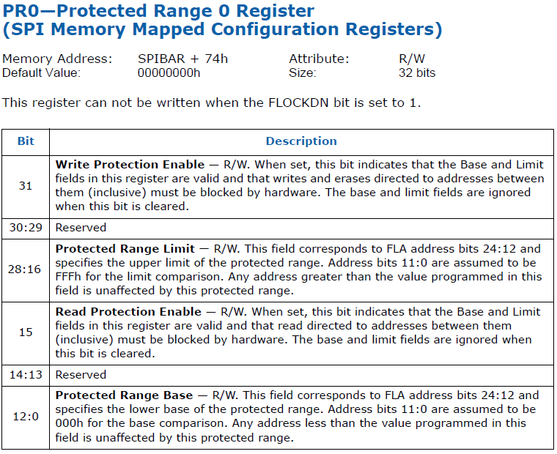

So who protects
the protector?
This guy that’s who!
We’ll get to that later
Example of a Protect Range Register
Notes:
Move to after we cover the FD and the flash masters

Slide 22
Protected Range (PR) Registers
The protections prescribed herein are enforced even upon the SMI handler
Enforced on register access, not direct access, however
Protected ranges are available to a SPI flash operating in either Non-Descriptor mode or Descriptor mode
The ranges don’t have to mirror descriptor mode regions
Base addresses must be page-aligned
Lower 12 bits are 000h
Limit addresses end at one under a page aligned boundary
Lower 12 bits are FFFh
Addresses are Flash Linear Addresses (FLAs)
Basically an offset from the base of the flash
So “offset” 0x260000 on the flash is Flash Linear Address 0x260000

Slide 23
PR Sample: 03FF02A2h Base 2A2000h
Protected Range Base
31 | 30 | 29 | 28 | 27 | 26 | 25 | 24 | 23 | 22 | 21 | 20 | 19 | 18 | 17 | 16 | 15 | 14 | 13 | 12 | 11 | 10 | 9 | 8 | 7 | 6 | 5 | 4 | 3 | 2 | 1 | 0
WP |  |  | 0 | 0 | 0 | 1 | 1 | 1 | 1 | 1 | 1 | 1 | 1 | 1 | 1 | R P |  |  | 0 | 0 | 0 | 1 | 0 | 1 | 0 | 1 | 0 | 0 | 0 | 1 | 0
FLA_{base} = 2A2000h
24 | 23 | 22 | 21 | 20 | 19 | 18 | 17 | 16 | 15 | 14 | 13 | 12 | 11 | 10 | 9 | 8 | 7 | 6 | 5 | 4 | 3 | 2 | 1 | 0
0 | 0 | 0 | 1 | 0 | 1 | 0 | 1 | 0 | 0 | 0 | 1 | 0 | 0 | 0 | 0 | 0 | 0 | 0 | 0 | 0 | 0 | 0 | 0 | 0
To set a PR from a Flash Linear Address Limit:
PR_{base} = ((page-aligned FLA_{base}) & FFF000) >> 12
PR_{base} |= 2A2 = 0000002A2h
To write-protect this range: PR0 | = 80000000h
To read-protect this range: PR0 |= 00008000h
*We’re picking a funny base because the offset at the real BIOS base is normally all 0xFF’s so it’s harder to illustrate the point.
This example will show us a visible boundary whereas the real BIOS base address would not.

Slide 24
PR Example: 03FF02A2h Limit 3FFFFFh
Protected Range Limit
31 | 30 | 29 | 28 | 27 | 26 | 25 | 24 | 23 | 22 | 21 | 20 | 19 | 18 | 17 | 16 | 15 | 14 | 13 | 12 | 11 | 10 | 9 | 8 | 7 | 6 | 5 | 4 | 3 | 2 | 1 | 0
WP |  |  | 0 | 0 | 0 | 1 | 1 | 1 | 1 | 1 | 1 | 1 | 1 | 1 | 1 | R P |  |  | 0 | 0 | 0 | 1 | 0 | 1 | 0 | 1 | 0 | 0 | 0 | 1 | 0
FLA_{limit} = 3FFFFFh
24 | 23 | 22 | 21 | 20 | 19 | 18 | 17 | 16 | 15 | 14 | 13 | 12 | 11 | 10 | 9 | 8 | 7 | 6 | 5 | 4 | 3 | 2 | 1 | 0
0 | 0 | 0 | 1 | 1 | 1 | 1 | 1 | 1 | 1 | 1 | 1 | 1 | 1 | 1 | 1 | 1 | 1 | 1 | 1 | 1 | 1 | 1 | 1 | 1
To set a PR from a Flash Linear Address Limit:
PR_{limit} = (page-aligned FLA_{limit}) << 16
PR_{limit} = 3FF000 << 4 = 03FF02A2h
To write-protect this: PR | = 80000000h
To read-protect this: PR |= 00008000h

Slide 25
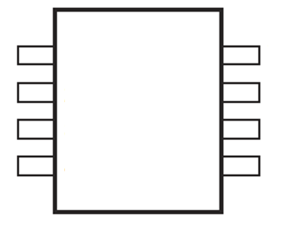
vulnBIOS Example: Protected Range Registers
260000h (start of BIOS region)
BIOS Region
3FFFFFh (BIOS limit)
On our lab E6400, the BIOS region occupies the range 260000 – 3FFFFFh on the physical chip
260000h and 3FFFFFh are Flash Linear Addresses (FLAs)
The CPU/BIOS (including us using RW-E) always has Read/Write access the BIOS region on flash
Per the flash master permission settings

Slide 26
vulnBIOS Example: Protected Range Registers
260000h (start of BIOS region)
2A2000h (start of protected range)
BIOS Region
3FFFFFh (BIOS limit)
The previous slides set up a protected range from 2A2000h to 3FFFFFh
PR = 03FF02A2h (has not yet been read/write protected)
On our lab machines, this covers a portion of our BIOS region

Slide 27
vulnBIOS Example: Protected Range Registers
260000h (start of BIOS region)
2A2000h (start of protected range)
BIOS Region
3FFFFFh (BIOS limit, end of protected range)
Let’s first verify we can read this by viewing the BIOS dump from Copernicus
PR = 03FF02A2h (has not yet been read/write protected)
On our lab machines, this covers a portion of our BIOS region

Slide 28
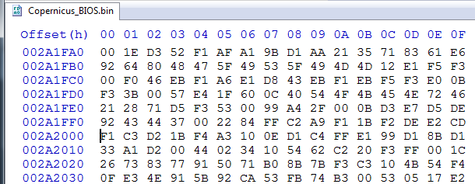
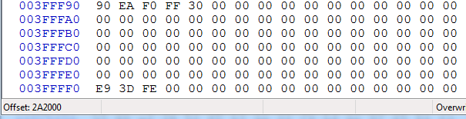
vulnBIOS example: Protected Range Registers
2A2000h (PR Start)
.
.
.
.
.
.
.
.
.
3FFFFFh (PR End (BIOS Limit))
First let’s establish that we have permission to read the BIOS region
Run Copernicus and open the .bin file with your favorite hex editor (HxD is a good one for Windows)
Observe binary range 2A2000-3FFFFFh
Looks like BIOS to me!

Slide 29
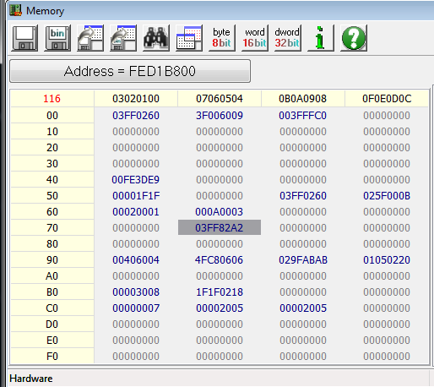
vulnBIOS example: Protected Range Registers
To Write-protect a range:
PR | = 80000000h
To Read-protect a range:
PR |= 00008000h
For this example let’s disable reads to this range:
Set PR0 (at SPIBAR + 74h) to 03FF82A2h

Slide 30
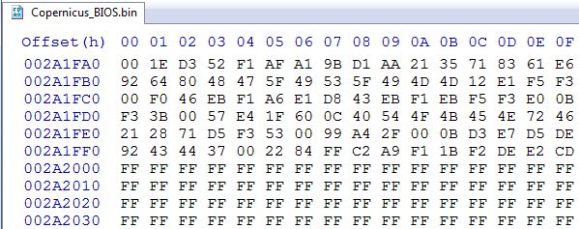
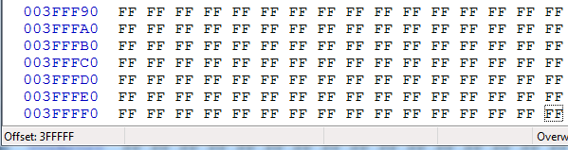
vulnBIOS example: Protected Range Registers
2A2000h (PR Start)
.
.
.
.
.
.
.
.
.
3FFFFFh (PR End (BIOS Limit))
Now re-run Copernicus and view the BIOS binary file in a hex editor
As you can see the Protected Range registers override the Flash Master permissions
This is the BIOS region to which the CPU/BIOS Master otherwise “always” has permission to read and write

Slide 31
PR Summary:
Implementing Protected Ranges is an important strategy for locking down a system BIOS
Without PR’s, any bypass of SMM’s global write-protection means an attacker is automatically able to modify the BIOS
Protected Range register enforcement:
Overrides the Flash Master permissions
Prevents Reads/Writes directly from the flash, even when the processor is running in SMM
We did not demonstrate this, but it is true
Because of this, BIOS updates (or updates to protected ranges) must be performed before the Protected Ranges are configured by the BIOS
Only the vendor can reliably configure PR’s since new UEFI BIOSes had a region of naturally changing content

Slide 32
FLOCKDN Register
When we were been able to easily modify (and re-modify) registers in the SPI configuration registers that are designed to protect the system
For example, we can configure and modify the protected range registers to suit the needs of a lab
But if we can change them, so can any other app capable of mapping SPIBAR
Intel provides the FLOCKDN register to solve this problem
Notes:
He who watches the watcher … FLOCKDN

Slide 33
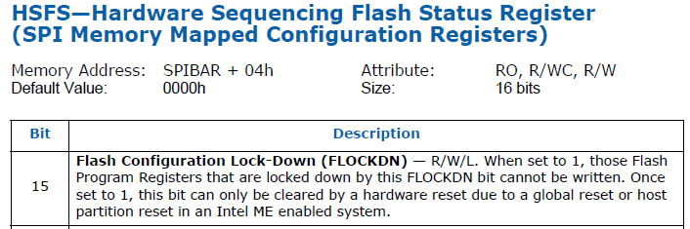
FLOCKDN
FLOCKDN, when asserted, prevents certain configuration registers/bits in the SPI BAR from being changed
Once asserted, FLOCKDN cannot be reset to 0 until a reset
Or can it? :) Snorlax & Darth Venamis on Day 5!
Although hardware-sequencing is available only in descriptor mode, the FLOCKDN bit still provides register lock-down protection when the flash is operating in non-descriptor mode
Called SPI or Flash Configuration Lock-Down bit

Slide 34

FLOCKDN Affected Registers (see your manual, but at the time of original class generation…)
Flash Regions Access Permissions Register (FRAP)
bits 31:24 (BMWAG) and bits 23:16 (BMRAG)
Protected Range (PR) registers 0 to 4
entire register is locked
Software Sequencing Flash Control Register (SSFC)
bits 18:16
Configure SPI Cycle Frequency (20 MHz, 33 MHz, or 50 MHz [PCH only])
Prefix Opcode Configuration Register (PREOP)
entire register is locked
Opcode Type Configuration Registers (OPTYPE)
Entire register is locked
Opcode Menu Configuration Register (OPMENU)
Entire register is locked

Slide 35
SPI Lockdown Summary 1
Locking down the SPI Flash is a little more complicated than locking down SMM
For the most part, only the vendor can do this, but you can verify and try to implement some yourself
Verify that BIOS_CNTL.BLE is set
Oh wait…we’re going to talk about something in a sec that completely bypasses BLE :)
If it’s not set, you can assert it yourself but that doesn’t mean there is SMI handler code present that will de-assert bit 0
Verify that SMM is protecting the BIOS from writes by asserting bit 0 and ensuring that it is reset
If supported, ensure that BIOS_CNTL.SMM_BWP is asserted so that the BIOS can only be written to when the processor is in SMM
You can set this yourself. The only drawback being that you may not be able to update the BIOS, depending on how the vendor implemented updates

Slide 36
SPI Lockdown Summary 2
Verify that Protected Range registers are being used
You could also set these yourself but it will be a trial and error exercise since you won’t know what parts of the BIOS flash will be used to store variables (UEFI definitely and some Legacy)
Set FLOCKDN to ensure the above registers can’t be changed
The above changes you could play with won’t permanently hurt your system if they lock it up – they will all reset back to their original values on startup
Verify that the Flash Master permissions are set and that the Flash Descriptor region cannot itself be written to
You have no control over this unless it is writeable, in which case the most you should do is make the FD un-writeable
Messing with this one could brick your system “permanently”

Slide 37
SPI Summary
Locking down the SPI flash memory is the first line of defense against an attacker
It is complicated and hard for vendors to get right
It gets a little more complex in UEFI where the SPI flash is specifically used as a file system for storing system variables
Can’t just set a single PR to write-protect the whole BIOS region
Remember:
The BIOS boots from the flash and is responsible for configuring all of the settings we have been discussing so far in the class
Letting an attacker modify the BIOS means game over
It’s not easy, but it’s not that hard either for an attacker to modify your BIOS flash

Slide 38
SPI Summary
All the settings in this section apply to both x86 and x64 architecture
All the settings in this section apply to both legacy BIOS and UEFI BIOS
All the settings in this section apply to systems running legacy MCH/ICH chipsets and the new PCH chipsets
Except where otherwise noted (SMM_BWP)

